Slide 1
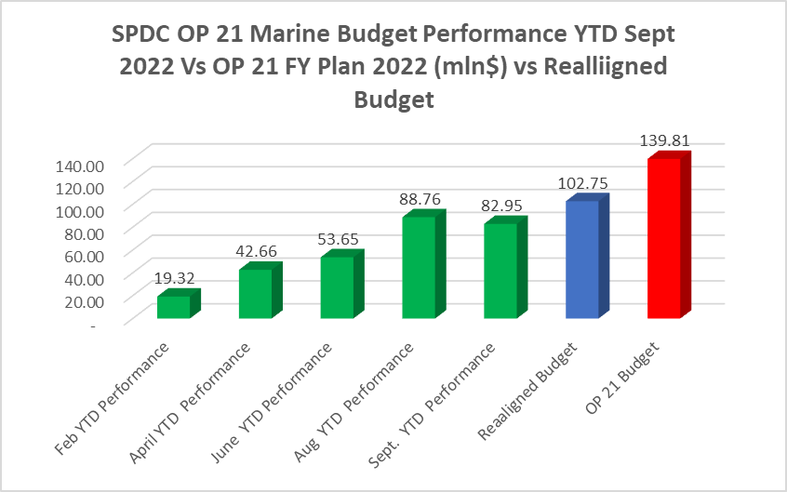
SPDC OP21 MARINE EQUIPMENT/BUDGET PLAN VS ACTUAL
Discuss
Sept 2022 YTD Budget Performance (Marine Vessel only Spend) - Spend of F$82.95m VS Realigned Budget of F$102.75m-( 81.%).
YTD Sept. Avg 2022 Vessel Demand Plan vs Actual- 175 vs 135. (Covers Security, Wells/WRFM, Pipelines, East, West, COG Projects). Excludes SNEPCo-11 and EPC vessels.
Overall, OP21 marine Equipment Demand vs Actual is within approved plan albeit budget realignment done, some reallocations done others ongoing.
*Marine Vessel Only Budget and spend Common Costs and AF

